Slide 1
Deep Learning-Based Disease Detection in Citrus Plants :
A Comparative Analysis

Slide 2
Team Members
Md Sheikh Abu Hanjala
190204004
Shamsia Haque Sristy
190204038
Md Shiful Islam Piash
190204041
Kazi Atiqur Rahman
190204086

Slide 3
MD SHEIKH ABU HANJALA
190204004
SHAMSIA HAQUE SRISTY
190204038
MD SHIFUL ISLAM PIASH
190204041
KAZI ATIQUR RAHMAN
190204004
GROUP MEMBERS

Slide 4
Table of contents
01.
Introduction
06.
Background Study
02.
Motivation
07.
Methodology
03.
Literature Review
08.
Result Analysis
04.
09.
Research Gap
Conclusion
05.
10.
Dataset
Future Work

Slide 5
01
Introduction

Slide 6
INTRODUCTION
Citrus are acidic fruits that is consumed worldwide.
Common citrus includes lemon, lime, orange, grapefruit etc.
These acidic fruits from which refreshing lemonades to tangy orange juices enjoyed by people worldwide
Despite their popularity and widespread cultivation, citrus trees are vulnerable to a range of diseases
that pose significant challenges to farmers and consumers alike.

Slide 7
Citrus Diseases Related to This Study
BLACK SPOT
GREENING
CANKER
MELANOSE
This study focuses on the early detection of citrus diseases using object detection models

Slide 8
02
Motivation

Slide 9
MOTIVATION
According to WORLD RESOURCES INSTITUTE wasted food costs the global economy more than $ 1 trillion every year. [1]
Impacting both agricultural productivity and the economic livelihood of farmers
Early detection of plant diseases can help
farmers to decrease production loss.
to reduce loss of production and increase the fruit’s quality.
Inspired by this, the thesis topic ‘Deep Learning-Based Disease Detection in Citrus Plants’ was chosen.

Slide 10
03
Literature Review

Slide 11
Literature Review
S.-M. Yao, M.-L. Wu, and T.-H. Hung, “Development of multiplex rt-pcr assay for the simultaneous detection of four systemic diseases infecting citrus,” Agriculture, vol. 13, no. 6, p. 1227, 2023 [3].
FOCUSED
FOCUSED
Detection citrus crop diseases:
Citrus Tristeza Virus (CTV),
Citrus Psorosis Virus (CPsV),
Citrus Tatter Leaf Virus (CTLV)
Citrus Variegated Chlorosis (CVC).
Used multiplex RT-PCR assay method for detection of these diseases .
FOCUSED
METHOD
Comparison between multiplex RT-PCR assay and simplex assay.
Multiplex RT-PCR showed higher detection limits.
SHOWS
RESULT

Slide 12
Literature Review
H. Wang, S. Shang, D. Wang, X. He, K. Feng, and H. Zhu, “Plant disease detection and classification method based on the optimized lightweight yolov5 model,” Agriculture, vol. 12, no. 7, p. Article 7, 2022 [4]
FOCUSED
FOCUSED
A plant disease detection and classification .
Utilized the YOLOv5 model.
FOCUSED
METHOD
Ghostnet
Weighted BoxFusion(WBF)
Bi-Directional feature pyramid -
network (BiFPN),
Improved Attentional Spatial Mechanism (IASM).
The optimized YOLOv5 model achieved an accuracy rate 11.8% higher than the original, with an F1 score reaching 92.65%.
TRAINED
RESULT

Slide 13
Literature Review
S. Lee, G. Choi, H.-C. Park, and C. Choi, “Automatic classification service system for citrus pest recognition based on deep learning,” Sensors, vol. 22, no. 22, p. 8911, 2022 [2]
FOCUSED
FOCUSED
creating a deep learning-based disease classification system for citrus plants.
Used various deep learning models, including EfficientNet, VGGNet, ResNet, DenseNet, and ViT.
FOCUSED
METHOD
EfficientNet, VGGNet, ResNet, DenseNet, and ViT.
For all models was 97%
TRAINED
RESULT

Slide 14
Literature Review
P. Chin, K. Ng, and N. Palanichamy, “Plant disease detection and classification using deep learning methods: A comparison study,” Journal of Informatics and Web Engineering, vol. 3, no. 1, pp. 155–168, 2024 [5].
FOCUSED
FOCUSED
Improving the accuracy of plant disease detection and classification methods .
Using an optimized and light-
weight YOLOv8 architecture
model.
FOCUSED
METHOD
On a small-scale plant disease dataset.
Was 72.2% for YOLOv8s with
CA mechanism.
TRAINED
RESULT

Slide 15
04
Research Gap

Slide 16
Research Gap
Limited Dataset Availability.
Real-Time Performance Optimization.
Lacks practical implementation.
Robustness to Leaf Occlusions and Variations.

Slide 17
05
Dataset

Slide 18
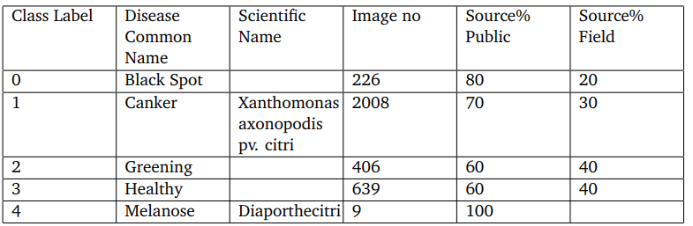
Dataset Collection
This study used a total of 3288 images approximately,taken from the citrus dataset
[6] [7].and 1000 images taken from nursery.
[ 8][ 9][ 10][ 11]
The infected images were divided into five (one healthy) groups, each representing a different disease of citrus leaves.
1.Black spot
2.Canker
3.Greening
4.Melanose
5.Healthy
were the diseases we studied in the datasets.
Table 1 : Information of Classes

Slide 19
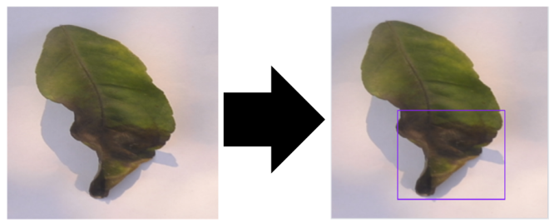
Annotation Process
Bounding boxes with information about the class and location of objects in the photos are included in the annotations.
Figure 1: Data Annotation in YOLO format
Dataset Distribution
To facilitate model training, validation, and evaluation, the dataset was split into three subsets:
• Train: 70%
• Validation: 20%
• Test: 10%

Slide 20
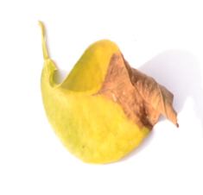
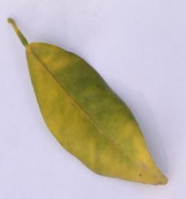
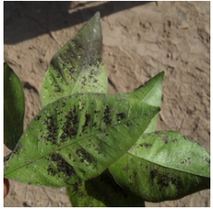
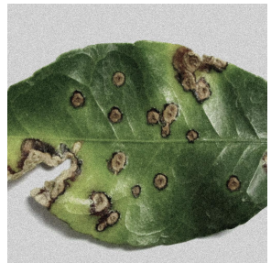
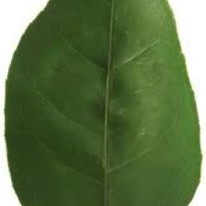
Dataset Acquisition
All Images have preprocessed before running the model.
The more commonly used Robo flow image preprocessing .
we used Image Data Generator which helps to rotate,zoom, increase brightness, and resize the images. We used an image size of (224, 224) pixels.
Also, the brightness were labeled to -30% to +30%
Figure 2 : Black Spot
Figure 3 : Greening
Figure 4 : Melanose
Figure 6 : healthy
Figure 5 : Canker

Slide 21
06
Background study

Slide 22
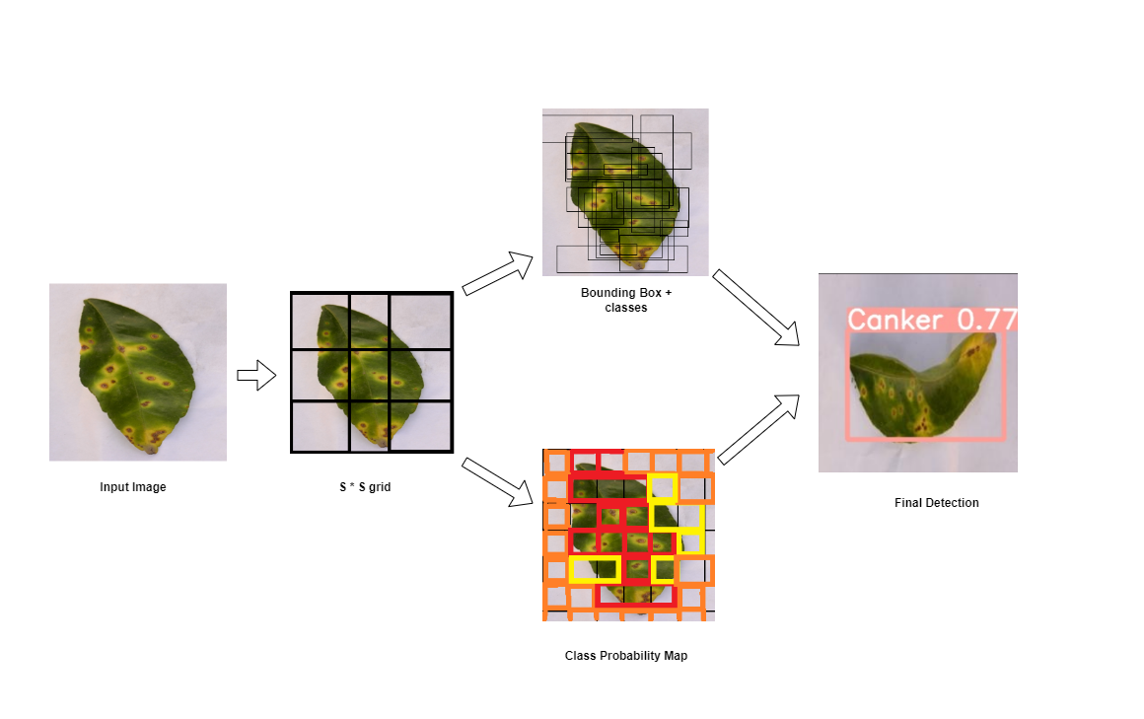
You Only Look Once(YOLO)
Real-time, single-pass object detection, incredibly fast and efficient
Grid Division
Cell Predictions (Bounding Box & Objects)
Class Prediction
Final Detection
Non-Max Suppression(NMS)
Figure 7 : How YOLO works

Slide 23
YOLOv5
Released in 2020, good balance between speed and accuracy and easy to use.
Anchor box-free Detection.
Filtered with NMS which removes overlapping boxes and choose the box with the highest probability.
YOLOv5’s architecture consists of three main parts:
> Backbone : New CSP-Darknet53 structure.
> Neck : SPPF and New CSP-PAN.
> Head : Generating Output.

Slide 24
YOLOv8
Introduced in 2022, it improves upon the YOLOv5 architecture, resulting in faster inference speeds.
Also uses, Anchor box-free Detection and filtered with NMS .
Includes mosaic data augmentation, a C2f module, a decoupled head, and a modified loss function.
Introduces dynamic scaling techniques for memory-efficient and faster.

Slide 25
YOLOv9
The latest version, released in 2024, boasts the best accuracy and speed among the three.
YOLOv9 tackles information loss with Programmable Gradient Information (PGI) for better gradients.
Utilizes Generalized Efficient Layer Aggregation Network (GELAN)'s efficient architecture for faster, accurate object detection.

Slide 26
07
Methodology

Slide 27
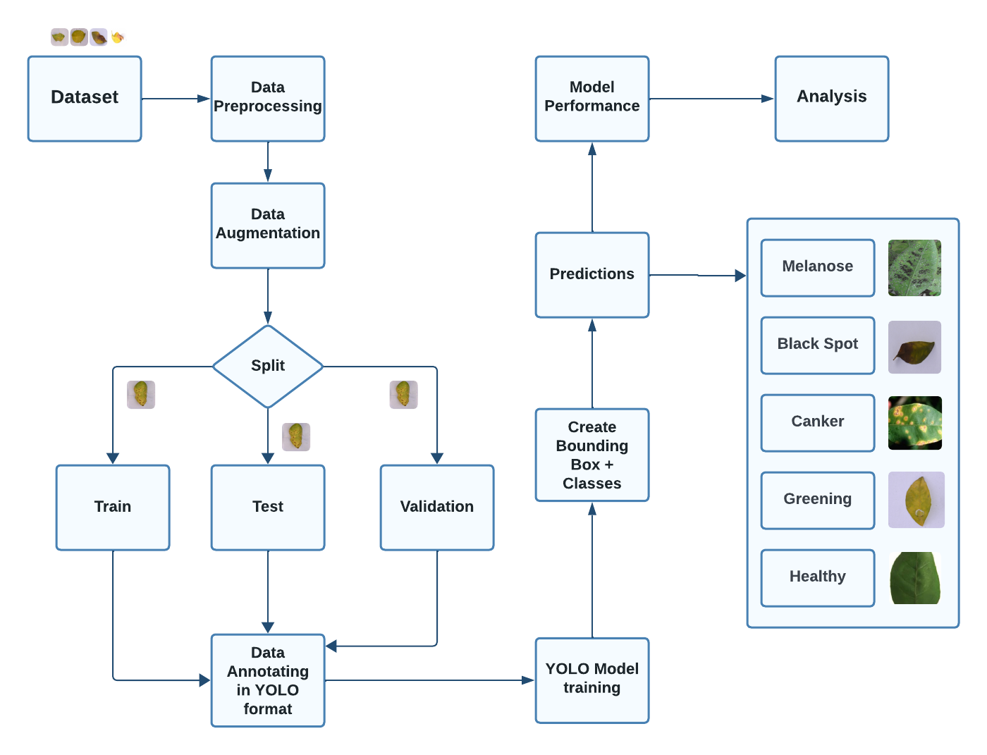
Methodology
Figure 8 : Methodology

Slide 28
08
Result Analysis

Slide 29
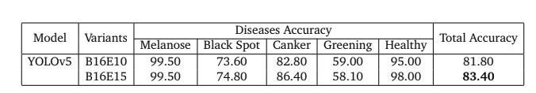

Accuracy (YOLOv5)
Figure: Various hyper-parameter analysis of YOLOv5
Figure: Model Evaluations of YOLOv5

Slide 30
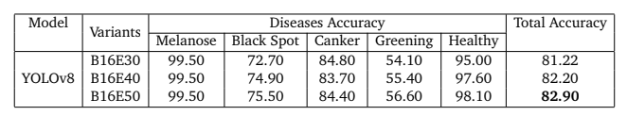
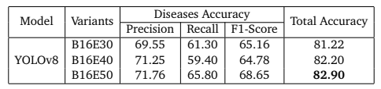
Accuracy (YOLOv8)
Figure: Various hyper-parameter analysis of YOLOv8
Figure: Model Evaluations of YOLOv8

Slide 31
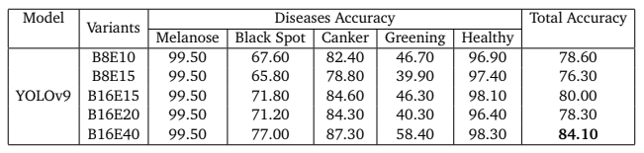
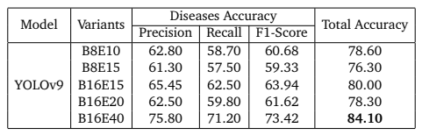
Accuracy (YOLOv9)
Figure: Various hyper-parameter analysis of YOLOv9
Figure: Model Evaluations of YOLOv9

Slide 32
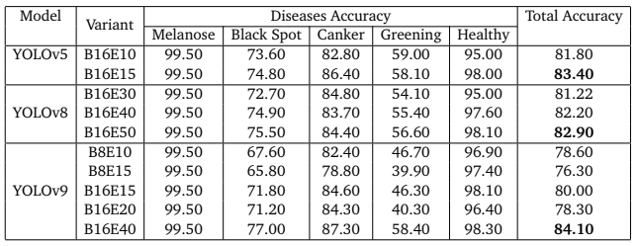
Overall Accuracy of Different Models
Figure: Comparative Analysis of YOLO MODELS

Slide 33
09
Conclusion

Slide 34
Conclusion
Effective Disease Detection in Citrus Leaves
Key Findings:
Effective in detecting citrus diseases
Enables proactive disease management in agriculture
Alerts farmers for immediate action
Impact:
Positive impact on citrus cultivation and Improves precision agriculture practices
Facilitates early disease detection and intervention
Leads to efficient resource allocation and reduced plant losses

Slide 35
10
Future Work

Slide 36
Future Work
Key Focus Areas:
Real-time disease detection
Implementing warning systems
Integrating weather data for enhanced detection
Developing a mobile app for immediate identification and treatment
Future Directions:
Expand dataset for further refinement and improvement
Include additional disease classes in the dataset
Explore real-time implementation with alert generation

Slide 37
Reference
[1]https://www.wri.org/insights/reducing-food-loss-and-food-waste
[2]https://pubmed.ncbi.nlm.nih.gov/36433508/
[3]https://www.mdpi.com/2077-0472/13/6/1227
[4]https://www.mdpi.com/2077-0472/12/7/931
[5]https://journals.mmupress.com/index.php/jiwe/article/view/807
[6] “Manual datasets of citrus leaf disease.” YoloV8m - Google Drivehttps://drive.google.com/drive/folders/1cd2j1aiUSqiGO1P2_YiQlg0W7HRlhwF.
[7] “Images dataset of citrus leaf disease.” Citrus Leaf Disease Image (kaggle.com)https://www.kaggle.com/ datasets/myprojectdictionary/citrus-leaf-disease-image.
[8] Kbd. Md. Nasirul. Alam, “Upazila agriculture officer, department of agricultural extension.”
[9] Anjum ashrafi Ononto, “Agriculture officer, department of agricultural extension.”
[10] T. Safwan, “Agriculture officer, department of agricultural extension.”
[11] H. H. Shanto, “Agriculture officer, department of agricultural extension.”

Slide 38
Thank You
Any Question?

